Slide 1
Functions and Classes

Slide 2
Objective
Structure Revisited
Introduction to Classes
Specify a Class
Defining member functions
Access Specifiers
Private Member functions
Array within a class
Memory allocation of an object
Object as function argument
Static Data Members & functions

Slide 3
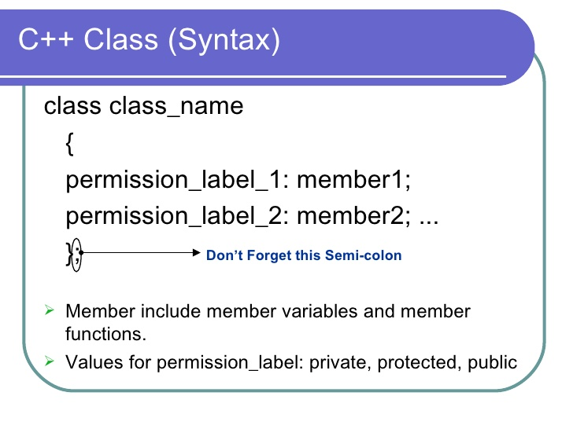
Introduction to Class
Class is a user define data type.
Class is a collection of data member and member function.

Slide 4
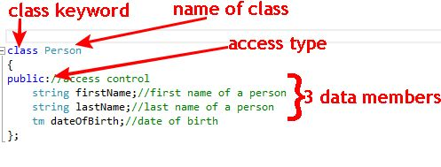
Specify a class

Slide 5
Defining member function
Member function Definition
Inside Class
Outside Class

Slide 6
Cont…
Inside Class definition
Class class_name
{
…….. ……. ………
public:
return_type funct_name(arg_list)//Function Definition
{
……
}
};

Slide 7
Cont…
Outside Class definition
Class class_name
{
…….. ……. ………
public:
return_type funct_name(arg_list); //Function Declaration
};
return_type class _name :: funct_name(arg_list) //Function Definition
{
……
}

Slide 8
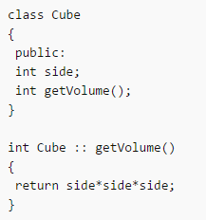
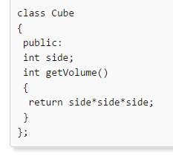
Cont…
Example Inside class definition
Example Outside class definition

Slide 9
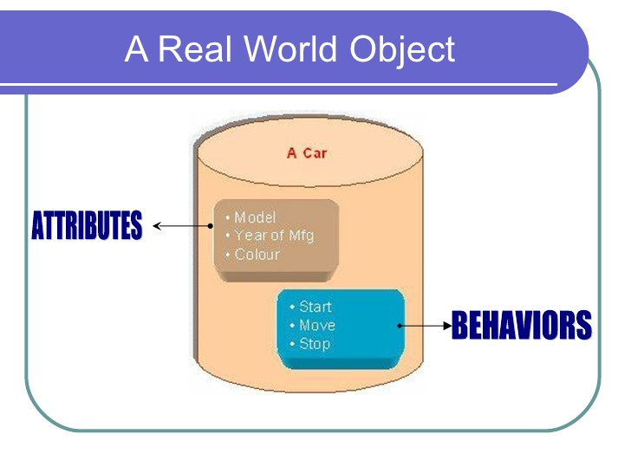
Object
Object is a class type variable.
Objects are also called instance of the class.
Each object contains all members(variables and functions) declared in the class.

Slide 10
Creating Object
Syntax:
Example:
Class_name Object_name;
cube cu;

Slide 11
Comparison between Class and Structure
Class
Structure
Keyword Class is used
Members of a class are private by default .
Can have constructor
It have data members and members functions
Keyword Struct is used
members of structure are public by default
Cannot have constructor
It deals with data.

Slide 12
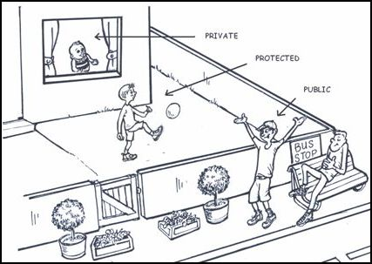
Access Specifiers
Access specifiers are keywords in object-oriented languages that set the accessibility of classes, methods, and other members.

Slide 13
Access Specifiers
Access Specifiers | Description
public | A public member is accessible from anywhere outside the class but within a program. You can set and get the value of public variables without any member function.
private | A private member variable or function cannot be accessed, or even viewed from outside the class. Only the class and friend functions can access private members.
protected | A protected member variable or function is very similar to a private member but it provided one additional benefit that they can be accessed in derived classes.

Slide 14
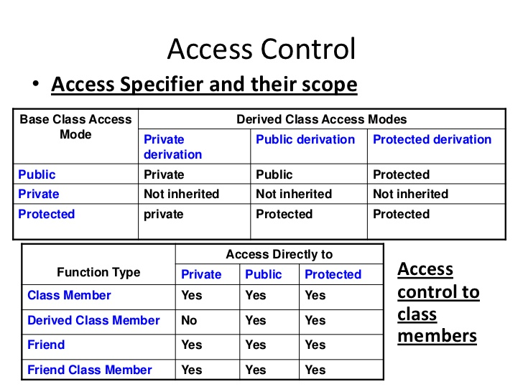

Slide 15
Private member functions
Private functions can only be called from within public member functions.
Even an object cannot invoke them using dot(.) operator.

Slide 16
Program on Private member functions
#include <iostream>
using namespace std;
class student
{
int marks;
void getvalue()
{
cout<<"enter marks";
cin>>marks;
}
public:
void display();
};
void student :: display()
{
getvalue();
cout<<"\nMarks are "<<marks;
}
int main()
{
student stu_obj;
stu_obj.display();
return 0;
}

Slide 17
Array within a class
When we are having an array variable defined with in the class this is known as array within the class.

Slide 18
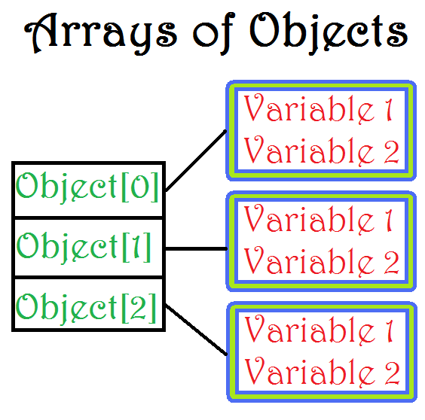
Array of Objects
An array of objects is a collection of objects of same class type that are stored in a contiguous memory location.
Syntax:
Class_name obj_name[size];

Slide 19
Program on array of objects
void display()
{
cout<<"\n Name"<<name;
}
};
int main()
{
person p1[10];
for(int j=0;j<=3;j++)
{
p1[j].getname();
p1[j].display();
}
}
#include <iostream>
using namespace std;
class person
{
char name[10];
public:
void getname()
{
cout<<"\nenter name";
cin>>name;
}

Slide 20
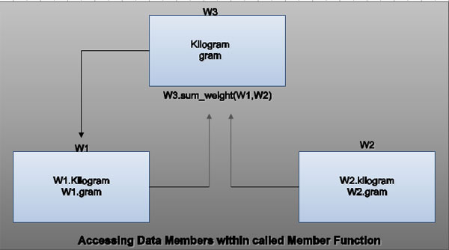
Object as function argument
The objects of a class can be passed as arguments to member functions as well as nonmember functions either by value or by reference.
When an object is passed by value:
a copy of the actual object is created inside the function. This copy is destroyed when the function terminates.
Moreover, any changes made to the copy of the object inside the function are not reflected in the actual object.
When an object pass by reference:
only a reference to that object (not the entire object) is passed to the function.
Thus, the changes made to the object within the function are also reflected in the actual object.

Slide 21
Cont..
Whenever an object of a class is passed to a member function of the same class, its data members can be accessed inside the function using the object name and the dot operator.
However, the data members of the calling object can be directly accessed inside the function without using the object name and the dot operator.

Slide 22
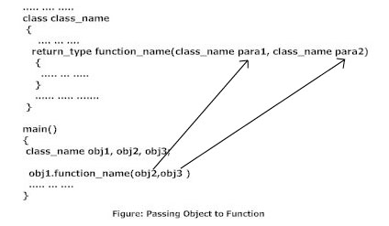
Syntax to pass object as argument

Slide 23
Program on Object as argument
#include <iostream>
using namespace std;
class getdata
{
int a=10,b=20;
public:
void value(getdata data,getdata data1)
{
int c;
c=data.a+data1.b;
cout<<"\n Sum is"<<c;
}
};
int main()
{
getdata data2,data3;
data2.value(data2,data3);
return 0;
}

Slide 24
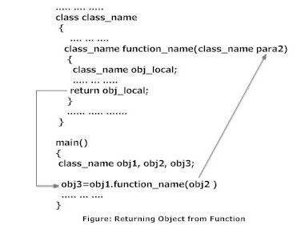
Returning Object

Slide 25
Program on returning object
add sum(add a1,add a2)
{
add a3;
a3.c=a1.a+a1.b;
return a3;
}
void show()
{
cout<<"\n Sum is"<<c;
}
};
int main()
{
add d;
d.getdata();
d=d.sum(d,d);
d.show();
return 0;
}
#include <iostream>
using namespace std;
class add
{
int a,b,c;
public:
void getdata()
{
cout<<"enter 1st value"<<endl;
cin>>a;
cout<<"enter 2nd value"<<endl;
cin>>b;
}

Slide 26
Friend function
A C++ friend functions are special functions which can access the private members of a class.
The declaration of friend function should be made inside the body of class starting with keyword friend.
Friend function is used when we need to operate on data of two or more objects of same or different classes.
Friend of the class can be member of some other class.
Friend functions are not member functions

Slide 27
Properties of Friend functions
It can't be called using object like other member function.
It is called like normal functions.
Private member can be accessed inside friend function using object name and dot(.) operator.
It can take multiple objects as parameter as required.
It should be declared in all the classes whose objects are sent as parameter.
It can be declared or defined in private, public or protected section of a class.

Slide 28
Program on friend function
#include <iostream>
using namespace std;
class add
{
int a,b,c;
friend void display(add);
public:
void getdata()
{
cout<<"Enter first number"<<endl;
cin>>a;
cout<<"Enter second number"<<endl;
cin>>b;
}
};
void display(add ad)
{
ad.c=ad.a+ad.b;
cout<<"sum is"<<ad.c;
}
int main()
{
add aa;
aa.getdata();
display(aa);
return 0;
}

Slide 29
Friend Classes
A friend class can access private and protected members of other class in which it is declared as friend.
It is sometimes useful to allow a particular class to access private members of other class.
Friendship is not mutual. If a class A is friend of B, then B doesn’t become friend of A automatically.
Friendship is not inherited.

Slide 30
Program on Friend Classes
class B {
public:
void show_value(A x) {
cout <<endl << "Accessing the value of friend" <<x.a;
}
};
int main()
{
A a;
B b;
a.getvalue();
b.show_value(a);
return 0;
}
#include <iostream>
using namespace std;
class A {
int a;
public:
void getvalue()
{
cout<<"Enter a value";
cin>>a;
}
friend class B; // Friend Class
};

Slide 31
Static Data members
We can define class members static using static key using static keyword.
When we declare a member of a class as static it means no matter how many objects of the class are created, there is only one copy of the static member.
A static member is shared by all objects of the class.
All static data is initialized to zero when the first object is created, if no other initialization is present.

Slide 32
Cont..
We can't put it in the class definition but it can be initialized outside the class as done in the following example by redeclaring the static variable, using the scope resolution operator :: to identify which class it belongs to.

Slide 33
Static member function
A static member function can be called even if no objects of the class exist and the static functions are accessed using the class name and the scope resolution operator ::.
A static member function can only access static data member, other static member functions and any other functions from outside the class.
Static member functions have a class scope and they do not have access to the this pointer of the class. You could use a static member function to determine whether some objects of the class have been created or not.

Slide 34
Program on static member
#include <iostream>
using namespace std;
class student
{
static int stnum;
public:
static void count()
{
stnum++;
}
void display()
{
cout<<"number of student is:\t"<<stnum<<endl;
}
};
int student :: stnum=1;
int main()
{
student s;
for(int i=1;i<5;i++)
{
student::count();
s.display();
}
return 0;
}

Slide 35
Member Dereferencing Operators
There are two pointer to member operators: .* and ->*.
The .* operator is used to dereference pointers to class members. The first operand must be of class type. If the type of the first operand is class type T, or is a class that has been derived from class type T, the second operand must be a pointer to a member of a class type T.

Slide 36
The ->* operator is also used to dereference pointers to class members. The first operand must be a pointer to a class type. If the type of the first operand is a pointer to class type T, or is a pointer to a class derived from class type T, the second operand must be a pointer to a member of class type T.
The .* and ->* operators bind the second operand to the first, resulting in an object or function of the type specified by the second operand.
If the result of .* or ->* is a function, you can only use the result as the operand for the ( ) (function call) operator. If the second operand is an lvalue, the result of .* or ->* is an lvalue.

Slide 37



